Slide 1
Boosting Algorithm in Machine Learning

Slide 2
Ada Boost algorithm:
It is a meta-estimator that begins by fitting a regressor on the original dataset and then fits additional copies of the regressor on the same dataset but where the weights of instances are adjusted according to the error of the current prediction.
Simple to implement and requires minimal hyperparameter tuning.

Slide 3
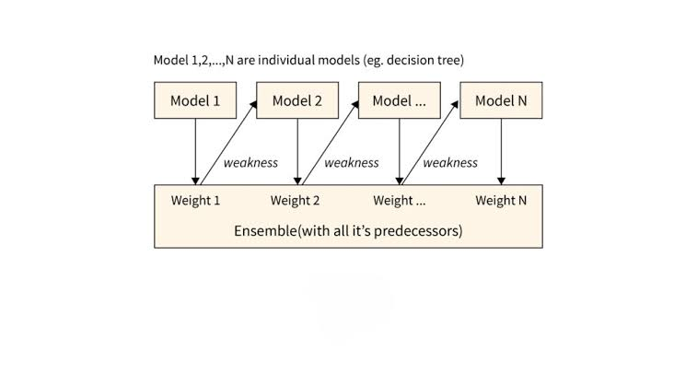
Builds weak learners one after another.
Each new model gives more importance to samples with larger prediction errors.
Final prediction is a weighted combination of all learners.

Slide 4
XG Boosting algorithm:
XGBoost (Extreme Gradient Boosting) is an advanced, highly scalable implementation of the gradient boosted decision tree algorithm.
In regression, it sequentially builds shallow decision trees to predict continuous numeric values (e.g., prices, temperature) by minimizing a loss function and applying regularization to prevent overfitting.

Slide 5
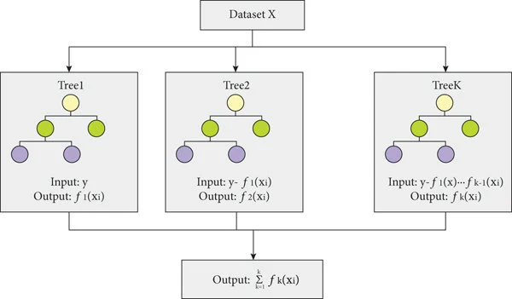
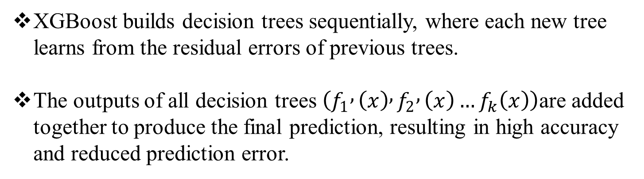
XGBoost builds decision trees sequentially, where each new tree learns from the residual errors of previous trees.
The outputs of all decision trees $\left(f_{1} , \left(x\right) , f_{2} , \left(x\right)…f_{k}\left(x\right)\right)$are added together to produce the final prediction, resulting in high accuracy and reduced prediction error.

Slide 6
LG Boosting algorithm:
"LG Boosting" commonly refers to LightGBM (Light Gradient Boosting Machine), a highly efficient, open-source gradient boosting framework originally developed by Microsoft.
It optimizes the standard Gradient Boosted Decision Tree (GBDT) architecture to handle large-scale datasets with extreme speed and lower memory consumption.

Slide 7
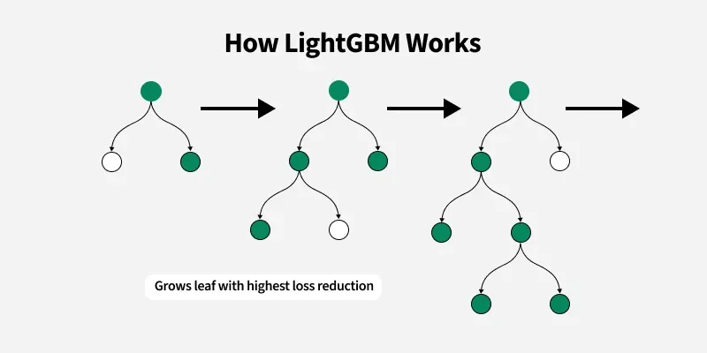
Grows trees leaf-wise rather than level-wise.
Faster training and lower memory usage on large datasets.
Excellent for high-dimensional and large-scale data.

Slide 8
Comparison:
Feature | AdaBoost | XGBoost | LightGBM
Learning Style | Sequential boosting | Gradient boosting | Gradient boosting
Speed | Moderate | Fast | Very Fast
Memory Usage | Low | Medium | Low
Accuracy | Good | Excellent | Excellent
Best For | Small datasets | General ML tasks | Large datasets

